Slide 1
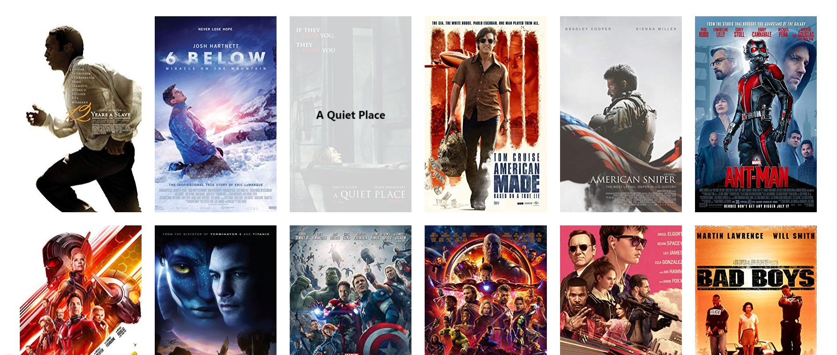
MOVIE SEARCH USING PYTHON

Slide 2



Our Team
JIBIN JOHNY
PETER IRIOGBE
KENNEDY CHIKAODILI IDOKO

Slide 3


About Project:
Overview:
This project uses IMDbPY to search for movies and retrieve major information including cast, genres, year of release, rating, run time, languages, director, writer, and so on.
Technologies Used:
Python, IMDbPY, GitHub, Linux, Visual Studio Code…

Slide 4

Prerequisites:
Step 1: Install IMDbPY: You can install IMDbPY via pip package (We used “Bash" in Scripting).
pip install IMDbPY
Step 2: Install other dependencies
pip install pandas numpy boto3
Step 3: Set up a GitHub repository on GitHub, and clone the repository to your local machine (If required)

Slide 5

Major Points Overview:
1. Import Statements:
- The code begins with importing necessary modules: `pandas`, `numpy`, `boto3`, and `Cinemagoer` from the `imdb` package.
- These modules are essential for working with data, handling arrays, and interacting with IMDb data.
2. Creating an Instance of `Cinemagoer`:
- An instance of the `Cinemagoer` class is created using `instance = Cinemagoer()`.
- This class likely provides functionality related to searching and retrieving movie information from IMDb.
3. User Input and Movie Search:
- The user is prompted to input the full movie name.
- The code then searches for the movie using the `instance.search_movie(movie_name)` method.
- If a movie is found, it proceeds to retrieve detailed information about the movie.

Slide 6

Major Points Overview:
4. Extracting and Displaying Movie Information:
- The code extracts relevant details from the retrieved movie information:
- Title, IMDb rating, release year, genre, language, director(s), producer(s), cast (first 5), and writer(s).
- The `get_names()` function formats the names of people involved (e.g., directors, cast, writers).
- The information is printed to the console.
5. Handling No Movie Found:
- If no movie is found for the given name, a message is displayed indicating that either the name is incorrect or there is insufficient information.

Slide 7
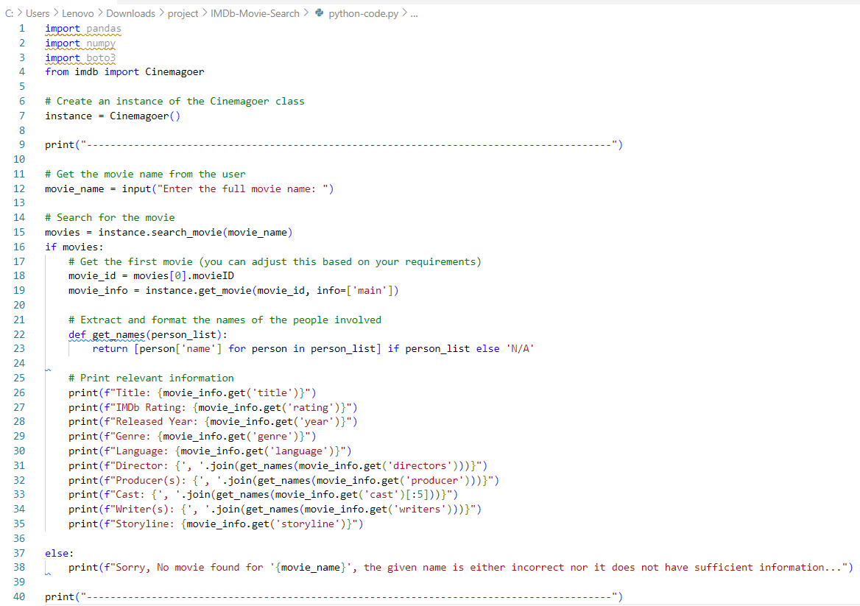

Its time to see our Code…..

Slide 8
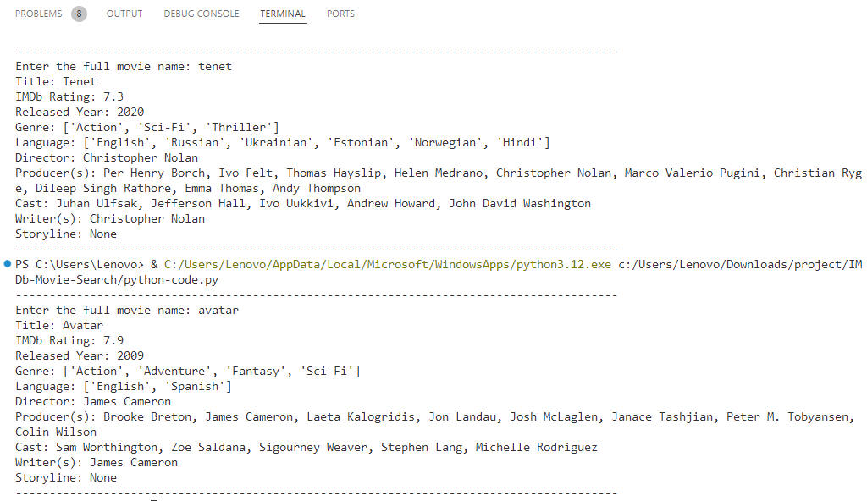
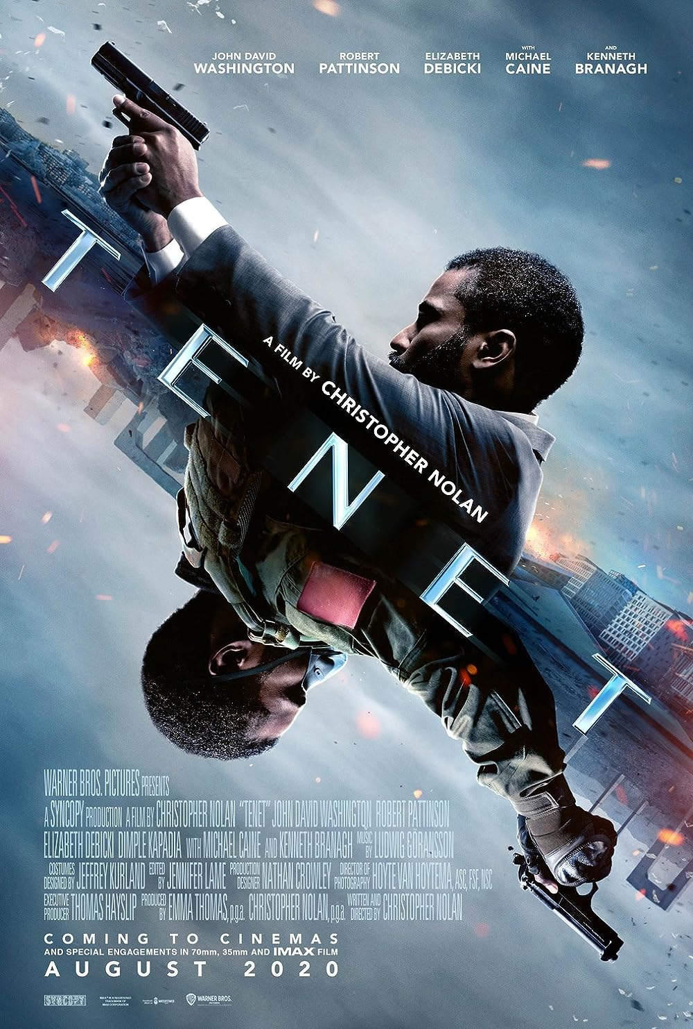
Lets See the Output….

Slide 9

THANKS
THANKS
Notes:
In Slide Show mode, click the arrow to enter the PowerPoint Getting Started Center.

